Slide 1

AMAZON SALES
DATA ANALYSIS REPORT
By: Suyash Gandhi

Slide 2
Problem Statement
Objective
Benefits
Help out to make better business decisions.
Help analyze customer trends and satisfaction, which can lead to new and better products and services.
Gives better insight of customers base.
Helps in easy flow for managing resources.
Sales management has gained importance to meet increasing competition and the need
for improved methods of distribution to reduce cost and to increase profits. Sales
management today is the most important function in a commercial and business
enterprise.
Develop a Report by Extracting-Transforming-Loading of data which contains Sales trend with respect to Year, Month, Quarter and find Some relationships through data to understand and Analyze the Facts.

Slide 3
Quick Insight
﻿A quick insight for Year 2010 - 2017 amazon sales.
513K
Unit Sales
137.3M
Revenue
44.2M
Profit
93.2M
Cost
9
Min Unit Price
668
Max Unit Price

Slide 4
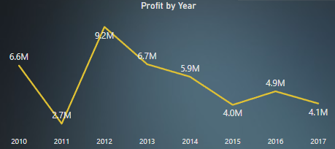
Total Sales for all the quarters
﻿2012 had the highest profit at 9.2M, followed by 2013 at 6.7M and 2010 at 6.6M

Slide 5
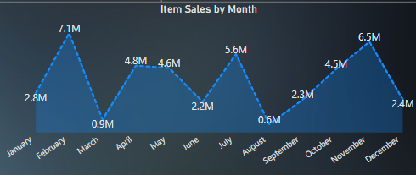
Monthly Sales Comparison
The sales in February and November for all year is high when compared and we can observe for March and August when sales drops.

Slide 6
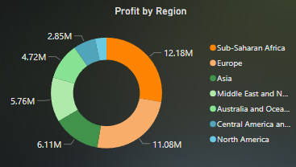
Profit Categorized By Region
Sub-Saharan Africa, Europe holds the maximum sales followed by Asia and Middle East and North Africa

Slide 7
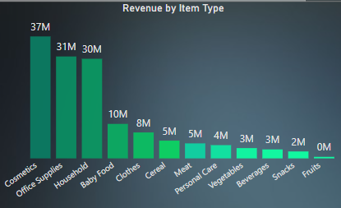
Revenue by Item Type
Cosmetics, Office Supplies and Household items returns the most revenue to the company

Slide 8
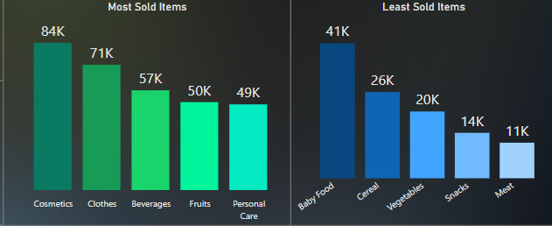
Top 5 Items: Most & Least Sold
Cosmetics sells the most and Meat sells the least

Slide 9
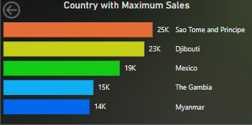
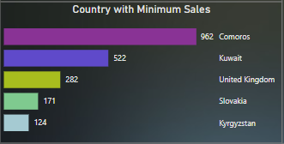
Top 5 Countries: Max & Min Sales

Slide 10
Conclusion
1. ﻿2012 had the highest profit at 9.2M, followed by 2013 at 6.7M and 2010 at 6.6M.
2. The sales in February and November for all year is high when compared and we can observe for March and August when sales drops.
3. Sub-Saharan Africa, Europe holds the maximum sales followed by Asia and Middle East and North Africa.
4. Cosmetics, Office Supplies and Household items returns the most revenue to the company.
5. Cosmetics sells the most and Meat sells the least.

